Slide 1
British Airways
Predictive model and its results
2023/23/5

Slide 2
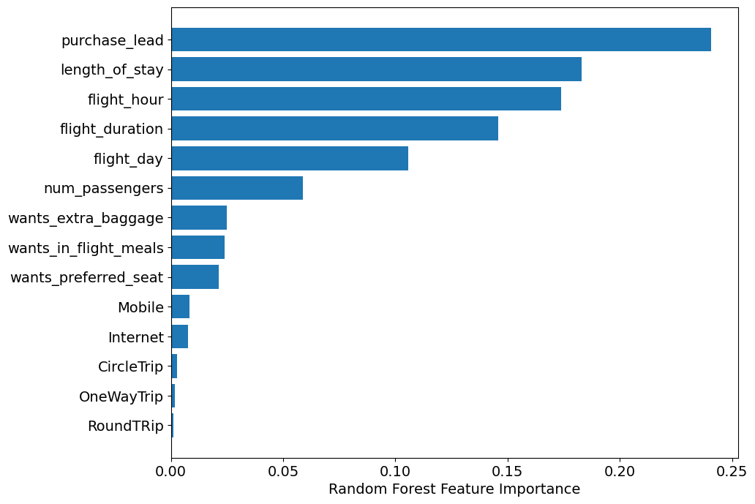
Predictive modelling results
Recall Rate
60%
Precision
61%
The probability of accurately predicting successful bookings.
It represents the ratio of correctly predicted completed bookings to the total number of successfully completed bookings.
66% Chance of predicting true incomplete bookings correctly.
Accuracy of the model predicting successful or incomplete booking is
Accuracy
62%
Key factors that contribute to successful flight bookings.
Our main concern is the accurate prediction of successful bookings. Although an imbalanced dataset may yield higher accuracy, it does not necessarily reflect the accurate prediction of successful bookings.
To address this, we balanced the dataset by including 8,000 labeled incomplete bookings and 7,000 labeled complete bookings.

